Slide 1
FAFSAs and FANs
3/21/2022
Lauren Greider
OSFS
IUPUI

Slide 2
FAFSA Completions

Slide 3
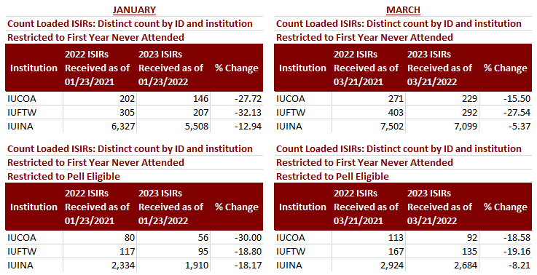
FAFSA Completions

Slide 4
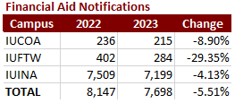
Financial Aid Notifications (FANs)

Slide 5
Student Outreach
Working with ESI to utilize AJ for messaging to students
  Admits/Deposits without a FAFSA
  Admits/Deposits with a FAN

Slide 6
Enrollment by financial aid characteristics
3/21/2022
Steven Graunke
IRDS
IUPUI

Slide 7
Offers, Deposits, and spend to date

Slide 8
Deposits by week

Slide 9
3/21/22 Deposits by Financial aid
 | Fall 2020 | Fall 2021 | Fall 2022
FAFSA Filers | 1,893 | 1,781 | 1,540
Pell eligible | 796 | 696 | 636
21st Century Scholars | 452 | 343 | 325
O’Bannon eligible | 321 | 291 | 253
Pledge Grant recipients (need-based) | 662 | 544 | 492
Jaguar Excellence (merit-based) | 769 | 1,034 | 965

Slide 10
3/21/22 Deposits by Financial aid
 | Fall 2020 |  |  |  | Fall 2021 |  |  |  | Fall 2022
 | All Offers | Deposits | Yield to date | Total dollars (Deposits) | All Offers | Deposits | Yield to date | Total dollars (Deposits) | All Offers | Deposits | Yield to date | Total dollars (Deposits)
Pledge Grant (need-based) | 2,150 | 662 | 30.8% | $1,826,009 | 1,741 | 544 | 31.2% | $1,656,581 | 1,726 | 492 | 28.5% | $1,433,595
Jaguar Excellence (merit-based) | 5,010 | 769 | 15.3% | $1,723521 | 6,037 | 1,034 | 17.1% | $2,069,000 | 6,614 | 965 | 14.6% | $1,933,00

Slide 11
3/21/22 Deposits by Financial aid

Slide 12
Thank You!
Steve Graunke

